Slide 1


Building a cloud based IoT Platform to power the energy transition in The Netherlands
Digital Xchange – 6th June 2020
Lucas Jellema, CTO & Architect AMIS | Conclusion
Notes:
This is the story of a Dutch utilities company that is building an IoT Platform to collect real time metrics on energy consumption from hundreds of thousands of households in order to operate the heat grid with greater efficiency, predict demand and ultimately actively operate actuators in the field. This session explains the challenges in this process - from the embedded firmware, LTE-M communication, security and the automated provisioning to the cloud based platform for processing millions of data points, monitoring vast numbers of devices and publishing analytics to enterprise applications. Several architecture concepts are applied - decoupling and encapsulation, serverless and message driven. The platform is built on largely managed cloud services on Azure Cloud. An overview of the cloud solution is presented. We believe this platform will make a contribution against climate change.

Slide 2



Notes:
We all need energy in our homes
For heating, showering, cooking, lighting and Netflix/gaming/Webconferencing and charging our mobile phones
How is energy produced (where, when) and how is it delivered to our home?

Slide 3

Energy delivered to business and households
Coal
Wood
Gas
Electricity (gray or green)
H₂
Sound
Heat (warm water)
Quantum Fluctuations and Phonons

Slide 4

Energy delivered to business and households
Coal
Wood
Gas
Electricity (gray or green)
H₂
Sound
Heat (warm water)
Quantum Fluctuations and Phonons

Slide 5
Heat as energy carrier
Residual product in industry
Central, efficient, green production
Easy production from many sources (incl geothermy)
Low risk –
productiontransport, transfer & local processing
High energy storage capacity
Ready to use
for heating and showering
Two-way
support local heat production and return flow

Slide 6

Energy transition to counteract climate change
Why?
Non-carbon-based energy products to reduce CO2 production
More efficient energy production to reduce waste and surplus CO2
How?
Low impact - reuse existing technology & know-how, equipment and grid
Ready for scale – yet not through big bang implementation
Affordable

Slide 7
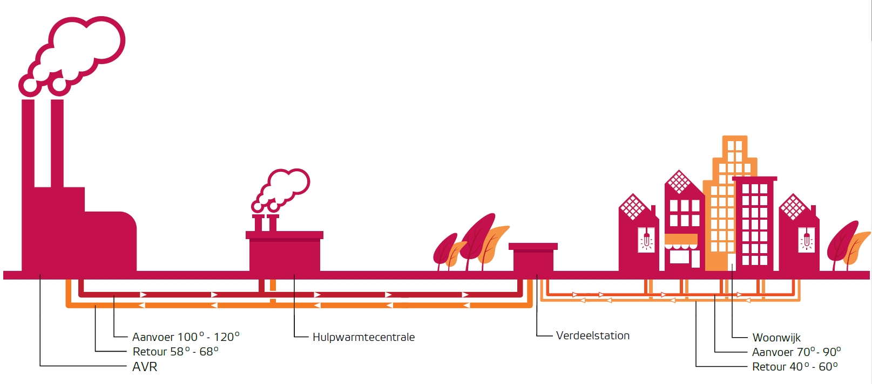
Heat as a Product

Slide 8
Heat as a Product

Slide 9
Heat as a Product
Supply (100°-120°)
Auxilliary Heat Production
Local Distributor
Consumer Homes
∆T
Return
Supply
Return (58°- 68°)
Supply (70°-90°)
Heat Production
Return
Return (40°-60°)

Slide 10
The Horizons and beyond
Generic method for reading smart meters
Uniform meter / micro controller with feedback option (local action)
Insight in usage of heat network and predicting and anticipating demand
Operate network on heat-demand in homes (link valve and thermostate)
Create end-to-end grid (data and control) of heat distribution system
Active control and balancing of heat network
More use of industrial residual heat/less gas-burning

Slide 11
A need to know basis
When & How much Energy transfered?
Also:
Volume, Supply & Return Temperature
Health details meters, communication, grid
Invoicing
Capacity Planning
Customer App/Portal/API
Heat Grid Analysis
Data Science
Customer Service/Helpdesk
Device Monitoring & Operations
HEAT

Slide 12
In Summary the Function of IoT Platform
Devices (100Ks)
IoT Platform
Enterprise Systems &
Third Parties

Slide 13
IoT Platform – To Insight and Action
Provision Devices
Physical World
High Volume in
Semi Real-Time
Monitoring Devices & Resolving Issues
Administrative Backend Systems
Customer Portals, Billing, Asset Management
Operate Smart Heat Networks
Publish cleansed, filtered data

Slide 14
IoT Platform – To Insight and Action
Insight in devices and their current and revent behavior – status, anomalies, measurements
Support Field Engineer during provisioning
Provision Devices
Physical World
High Volume in
Semi Real-Time
Monitoring Devices & Resolving Issues
Administrative Backend Systems
Customer Portals, Billing, Asset Management
Operate Smart Heat Networks
Publish cleansed, filtered data
Administrative registration of meters (assets) and their link to a grid connection (location & customer)
Receive messages: interpret, convert and route
Data Management
Device Metadata
Telemetry (lots of it)
Publish telemetry timeseries data
Interact with devices
Connectivity
Security
Protocol
Secure
Cost effective
Performant (now) & Scalable (later)
Short time to market

Slide 15

The moving pieces
Monitoring
Validate, Enrich Process, Convert, Publish
Event Streaming Platform
Communication Module
Ingest, Authenticate & Check
Smart Meter
API
Smart Meter
Devices
Telemetry
Actuator
HEAT

Slide 16
Orders of magnitude
Monitoring
150K devices
12M events/day
Validate, Enrich Process, Convert, Publish
Event Streaming Platform
Communication Module
Ingest, Authenticate & Check
Smart Meter
3.5M msg/day
API
Smart Meter
Devices
Telemetry
Actuator
70M records/day
HEAT
70M measurements/day

Slide 17

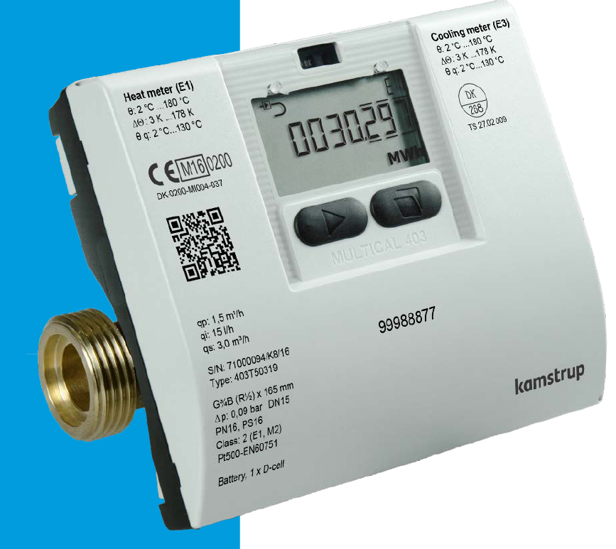
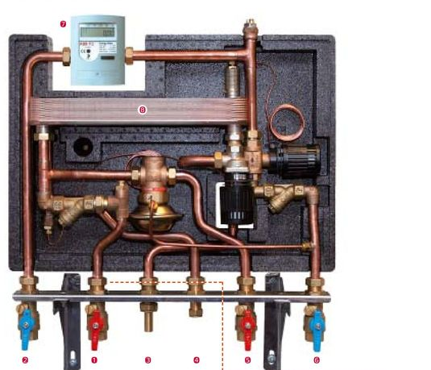
Smart Meters
Readings are digitally available through industry standard protocols – and wired or wireless.
Examples are Wired respectively Wireless M-Bus (for Heat Meters), and OpenTherm (thermostates)
Monitoring
Meters connect to pipes and use sensors to measure physical properties
Smart Meter
Event Streaming Platform
Ingest, Authenticate & Check
Validate, Enrich Process, Convert, Publish
Communication Module
API
Smart Meter
Devices
Telemetry
Actuator
Heat Meters measure actual Supply and Return Temperature (K), total Volume (m³) and Energy transferred (GJ), actual flow (m³). Heat Meters report health indicators. Meters retain history. Meters can publish error codes to indicate distress

Slide 18

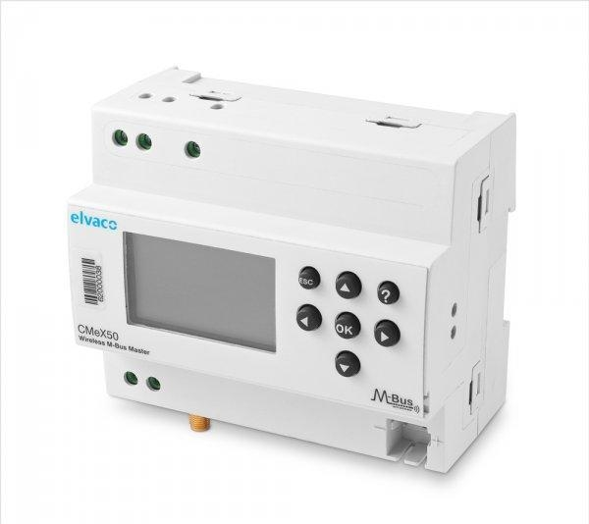
Communication Module and Communication Network
Communication Module reads values from the meter registers – through industry standard protocols like M-Bus and OpenTherm. Communication Module can read actual and historic values (from Meter memory). CM connects to meters through wires or wireless
Communication Module can send instructions to local actuators, for example to set a valve to a specific position
Monitoring
Validate, Enrich Process, Convert, Publish
Event Streaming Platform
Communication Module
Ingest, Authenticate & Check
Smart Meter
API
Smart Meter
Devices
Telemetry
Actuator
HEAT
Communication Module is edge device with firmware for on-device processing, SIM card that sends scheduled data reports over “Mobile” Communication channels (GPRS/3G/4G/LTE-M/LoRA) using protocols such as HTTP(S), MQTT and in data formats such as JSON, CSV, (XML,), custom, binary. CM can also receive instructions from device management systems.

Slide 19
Ingest
Monitoring
Ingest, Authenticate & Check
Validate, Enrich Process, Convert, Publish
Event Streaming Platform
Communication Module
Smart Meter
API
Smart Meter
Devices
Telemetry
Actuator
Only messages from known, provisioned, authenticated devices should be received and processed. The message should satisfy basic requirements (e.g. digital signature, valid JSON). Messages can arrive in high volumes. Initial processing is light weight, messages are quickly saved to queue for further, off-loaded processing
HEAT

Slide 20
Process, Persist and Publish
All business relevant telemetry messages are published to an Event Platform in canonical enterprise format. This platform is the corporate data exchange, high volume, fully decoupled. Billing/invoicing, capacity planning, data science, customer app are all subscribed to the platform.
Telemetry messages from various types of meters and communication modules are deduplicated, converted into standard units and canonical value labels. Administrative connection details are added to the published messages
Monitoring
Event Streaming Platform
Validate, Enrich Process, Convert, Publish
Communication Module
Ingest, Authenticate & Check
Smart Meter
API
Smart Meter
Devices
Telemetry
Actuator
HEAT
Telemetry data can be retrieved through REST APIs – per device, per day (primarily for monthly bill)
Telemetry data is stored in a Time Series database, allowing for very rapid (append only) recording of timestamped data, quick time-based aggregations and analysis and period-based data consolidation and data pruning,

Slide 21
Monitor & Operate
The health of smart meters, communication modules and communication networks need to be monitored in real-time – and in case of deviations of expected & desired behavior, alerts should trigger correcting actions. Note: this monitoring is not about the business meaning of telemetry.
Monitoring
Validate, Enrich Process, Convert, Publish
Event Streaming Platform
Communication Module
Ingest, Authenticate & Check
Smart Meter
Provision
API
Smart Meter
Devices
Telemetry
Provisioning is a time-consuming, hard-to-scale, manual process: hooking up a new Communication Module to the enterprise backend, connecting it to smart meters, configuring the measuring & reporting regime
Actuator
HEAT

Slide 22
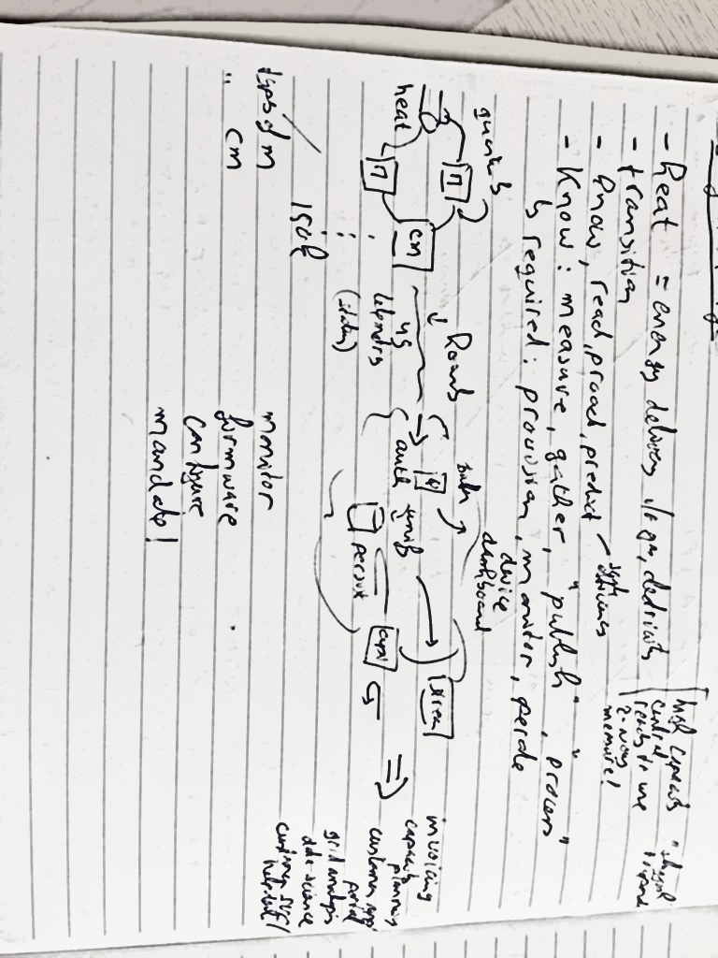
So far the What. Next is: How?
Monitoring
Validate, Enrich Process, Convert, Publish
Event Streaming Platform
Communication Module
Ingest, Authenticate & Check
Smart Meter
API
Smart Meter
Devices
Telemetry
Actuator
HEAT

Slide 23
Architecture Constraints & Business Requirements
Proven solution components
Quick time to market (two months from start to MVP in production)
Highly agile – many uncertaintities and changing priorities and insights
Embrace change in process, architecture, technology, culture
Publish all APIs through central APIGEE API Platform
Honor existing API definitions
Prepare for publication to event streaming platform (Apache Kafka)
Highly Available
initially Business Critical
prepare for Mission Critical
Scalable
periodic fluctuations
growth (to 100K+ devices in 2021)
TCO …
Constraints & Requirements

Slide 24
Architecture Principles & Choices
On Azure
Native PaaS much preferred over IaaS
On top of 3rd party managed Cloud Infra Landing Zone (Network, VMs, Storage, Accounts)
Key theme: decoupled
Logically (design time) – insulated against changes
Physically (run time) – insulated regarding availability, throughput and physical resource usage compartimentalized
Run time Azure decoupling mechanisms of choice:
Event Grid (operations), Queue (events), Database (data), Serverless, Service Plan (physical resource usage)
Automation
Auto-provisioning of CM, Infrastructure as Code, Continuous Delivery, Regression & Smoke Tests, Dynamic Scalability (rule based scale up and scale out), Alerts & Notifications

Slide 25





Ingest
Ingest, Authenticate & Check
Azure Function
Azure
IoT Hub
http/csv (VPN)
Communication Module
mqtt/json (open internet)
Devices
Azure
Database for PostgreSQL

Slide 26



Ingest
Validate, Enrich Process, Convert, Publish
Azure
Event Hub
Event Streaming Platform
Azure
IoT Hub
Telemetry
Devices
API
APGIGEE
Azure
Database for PostgreSQL

Slide 27

Challenges with IoT Hub and Function interaction
Event Hub
When a message is read from IoT Hub – it is gone
When processing that message fails – it is still gone
How to handle such failure?
How to handle multiple destinations for messages in IoT Hub?
How to handle multiple types of messages on IoT Hub with different processing and routing?
How to prevent Device Pilot from getting just anything flowing through IoT Hub?
Bonus: how to implemement fire-and-forget style function-to-function calls?
Function
IoT Hub
ESP
Function
Telemetry Timeseries
Notes:
https://docs.microsoft.com/en-us/azure/event-grid/overview

Slide 28
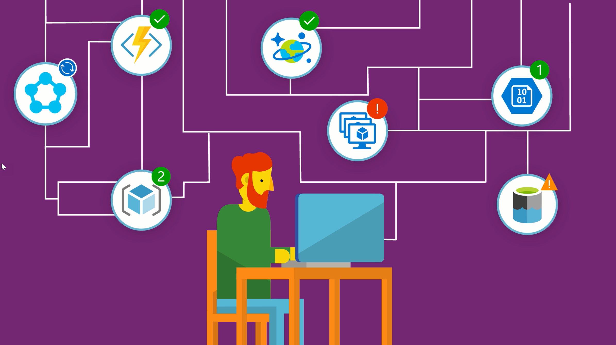
Azure Event Grid
Define light weight “topics”
Many Event Sources can be made to publish to these topics
And Functions can publish to them as well
Subscriptions connect Event Handlers to a Topic
They can have filters
They can have retry policies
They can have dead-letter-queues
This allows decoupled calls between Functions
With retry policies
Also: connect IoT Hub/Event Hub to functions and to each other
Notes:
https://docs.microsoft.com/en-us/azure/event-grid/overview

Slide 29
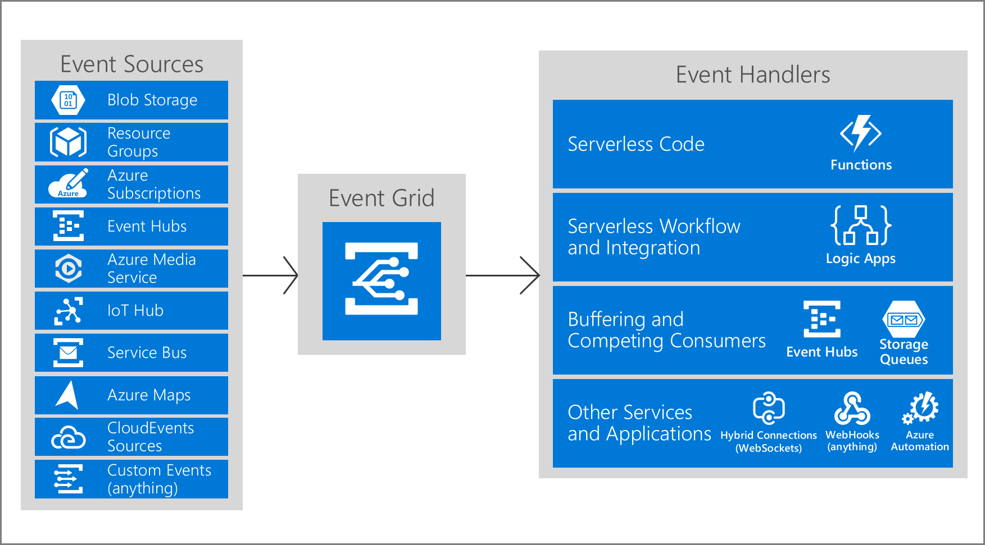

Azure Event Grid
Subscriptions
Topics
Filters
Retry Policies
Dead Letter Queue
Notes:
https://docs.microsoft.com/en-us/azure/event-grid/overview

Slide 30
Leverage Event Grid for filtering and fanning out messages and for implementing retry policies
2
ESP
1
3
Telemetry Timeseries
4
0
mqtt
5
6
7
8
0 – Event Grid subscription on IoT Hub
1 – Function Triggered by messages from certain device types
2 – Event Hub fed from /telemetry topic
3 – ESP Publisher function – fed from /telemetry topic
4 – Data Persister function - – fed from /telemetry topic
5 – Message Dispatcher
6 – Function Handlers for Status, ScanResult, ButtonPressed, Boot
7 - Retry and Dead letter configuration on every route to Blob Storage
8 – Monitor Dead letter queue
9 – Automated processing of dropped messages
Ops Monitoring
9
Dead letter queue
Automated Retry

Slide 31
Ingest
Validate, Enrich Process, Convert, Publish
Azure
Event Hub
Event Streaming Platform
Azure
IoT Hub
Telemetry
Devices
API
APGIGEE
Azure
Database for PostgreSQL

Slide 32


Provision
Provision
Azure
IoT Hub
Communication Module
Provision
APGIGEE
Azure
Device Provisioning Service
Devices
Register Device:
identifier, model/type, profile, certificate, firmware version,
Azure
Database for PostgreSQL
Communication Module
Smart Meter

Slide 33
Provision
Provision
Azure
IoT Hub
http/csv (VPN)
Communication Module
Provision
mqtt/json (open internet)
APGIGEE
Azure
Device Provisioning Service
Devices
Azure
Database for PostgreSQL
Communication Module
Smart Meter

Slide 34
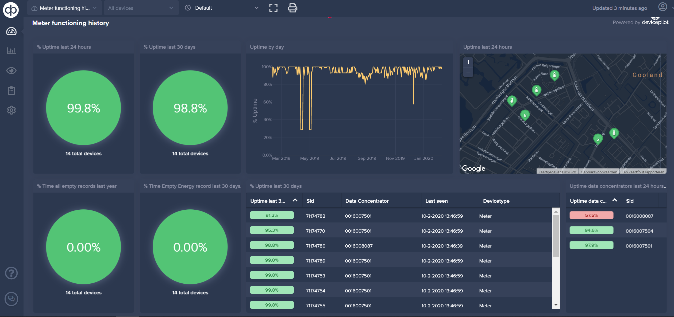

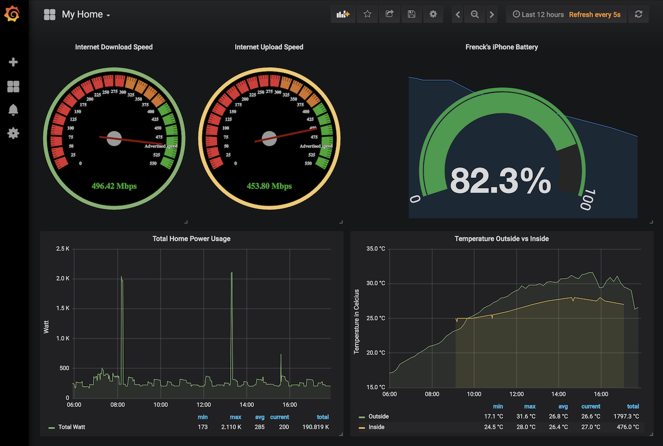


Ingest
Monitoring
Azure
IoT Hub
Telemetry
Devices

Slide 35
Process, Tools and Lessons Learned

Slide 36

What are our deliverables?
API Definitions (Swagger/OpenAPI)
Database Object Definitions (PostgreSQL & InfluxDB)
Azure Function Apps and Functions
Java
JavaScript
Azure DevOps Pipeline Templates (ARM)
Azure Resource provisioning (Infra as Code)
Application deployment (Function Apps, Database)
Postman Tests for APIs
Dashboard panels and Alert definitions in Device Pilot and Grafana
Ops checklists | instructions | tools

Slide 37

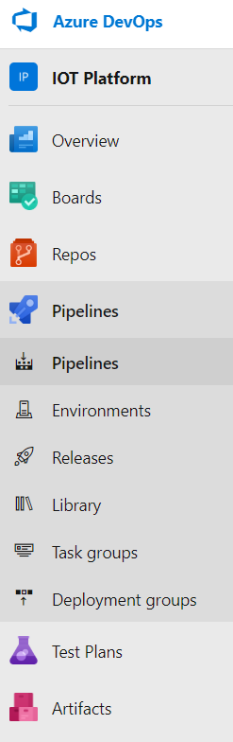
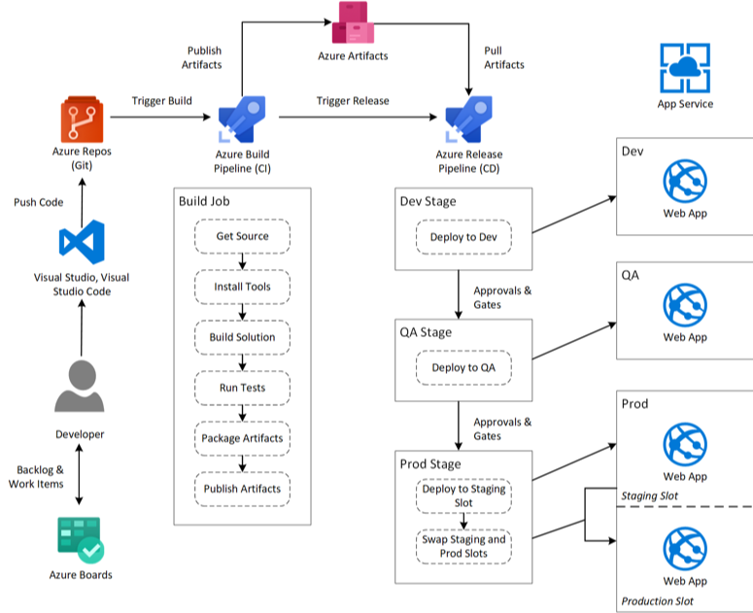



Azure DevOps
Build Pipelines – TerraForm or ARM templates, read keys from Key Vault and apply environment specific configuration values; run on build servers against Azure resource APIs
Wiki – for design decisions, technical debt, solution designs, technical documentation (yes, TFM)
Store and manage build products
(ready-to-rollout deployment artifacts)
Wiki
Git repositories with branches, pull requests, code reviews, web hooks (to trigger pipelines)
Boards - used for managing Work Items (stories, issues, features, epics)

Slide 38


Guilty Measure
M

Slide 39
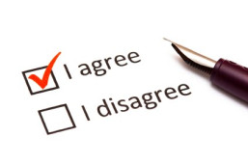
Smart Meters may only Measure when Explicitly Permitted
EU regulations state
From 2020 every new utility meter (gas, electricity, heat, cold, warm water) must be a smart meter; existing meters to be smartened asap
Every consumer should be allowed near real-time access to their consumption data
Data can only be collected from a smart meter if the consumer has given explicit consent to the distribution system operator (== meter operator) *)
*) exception: measurements for purpose of device monitoring and one yearly collection for the annual bill
Notes:
EU on smart meters https://www.emissions-euets.com/internal-electricity-market-glossary/1439-smart-metering
The so-called 'Winter Package' defines a 'smart metering system' as an electronic system that can measure energy consumption, providing more information than a conventional meter, and can transmit and receive data for information, monitoring and control purposes, using a form of electronic communication

Slide 40

Solution Design for Mandate Handling
Device Pilot
Synchronize Device
IoT Hub
/device-metadata-update
MQTT CM
Configurator
Mobile Provider Portal
CM Config Updater
Consent Management System
/device-configuration-instruction
Mandate Handler
APGIGEE
Communication Module & SIM
Device Database
Azure

Slide 41
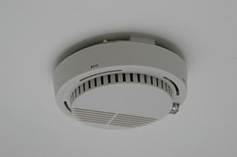

Smoke Test
Testing important end-to-end flow or functional chains as black box
Check for [expected] Output for a specific input
Check [trend in] processing time
Same tests [parametrized] in every environment – including ACC and PROD
Especially in ACC and PROD!
Run smoketests periodically throughout the day
Smoketest is used to detect
Impact of changes in infrastructure (network connectivity, permissions), platform configuration, application definition, system load
Expiration of certificates, passwords, credentials and other expirational resources
Smoke Testing in Production introduces “Fake News”
‘fake’ business objects (communication modules, meters, grid connections, locations, metrics) in the production environment
Arrange cross-team scope of testing or block fake objects from bleeding outside

Slide 42

Some Lessons (re) Learned
Naming stuff is very important
Stories, Code Repos, Code Objects (class, function, variable, parameter), …
Peer Review is required for shared code ownership and focus on full scope of Definition of Done
Documentation of technical design (overview) and functionality complements code and tests
Full automation – no compromises. No hands touching ACC or Prod
Smoke Testing – validate impact (for real) of any (combination of) changes
Thinking about testing upfront helps improve design
Do ‘job rotation’- prevent dependencies on ‘the local expert’
Verify assumptions, such as “That should work” and “That will not have any impact”
Explore Azure services – for features and limits (and cost calculation)
Leveraging Azure requires substantial Cloud Infrastructure skills
This Photo by Unknown Author is licensed under CC BY-SA

Slide 43
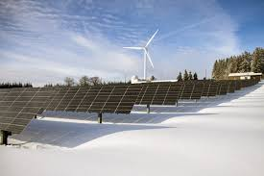

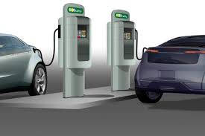
Broader IoT Platform objectives/ Next Steps
Single point of entry for all operational data
Solar Farms
Windmills
Central Heating (gas powered)
EV charging
Active, Real-Time Operations (two way data stream)
Act
Pro-act

Slide 44
Conclusion
IoT is [a special case of] data integration
Collect, process, persist, publish
Fast, High Volume
Many parties to interact with
IoT brings physical world of real things close to enterprise IT
Automation is a lot of work – and is worth it
Speed, repeatability, ability fo agility, reduced effort, less reliance on key resources
Having [regression and smoke] tests in place helps spot many different types of issues early on
Anything local (edge side), physical, manual is expensive and hard to scale
Azure is a pretty nice environment to work and run in
Some things we particularly like: Functions, Event Grid, Azure DevOps
And: the ability to rapidly ramp up, explore, scale and let go off

Slide 45


Thank you for your attention I hope this was useful
lucas.jellema@amis.nl | technology.amis.nl | @lucasjellema | lucas-jellema

